Slide 3
SUPPORT FIRST RESPONDERS
Freight railroads annually train tens of thousands of first responders.
In 2014, the Class I railroads worked with Railinc, Amtrak, the International Association of Fire Chiefs and the Association of American Railroads (AAR) to develop the free app.
AskRail helps emergency responders respond more quickly and safely to rail incidents.

Slide 4
AVAILABLE TO QUALIFIED FIRST RESPONDERS
Emergency Communication Centers can download the Windows version and provide data directly to emergency responders.
Nearly 50,000 first responders have individual access so far, while thousands more are covered by their local Emergency Communication Centers.

Slide 5
PROVIDES IMMEDIATE INFORMATION
Provides emergency responders with accurate, real-time information about railcars carrying hazardous materials on a train.
Use a simple railcar ID search to see whether a railcar on a train is carrying hazmat and to view contents of entire train.
View a map of nearby railroad mileposts, grade crossing locations, schools, hospitals and more and follow instructions for where to establish isolation zones.
Access the DOT Emergency Response Guide and find emergency contact information for all Class I railroads, and Amtrak and participating shortlines.

Slide 7
HAZMAT VS. DANGEROUS GOODS
Hazardous Materials are defined by The U.S. Department of Transportation (DOT) and the International Air Transportation Association (IATA) as “articles or substances which are capable of posing a risk to health, safety, property, or the environment; are listed or classified in the regulations; and are transported in commerce.”
Dangerous goods are products, substances, or organisms that are harmful to life, health, property, or the environment. Products are identified and regulated by the Transportation of Dangerous Goods regulations.

Slide 8
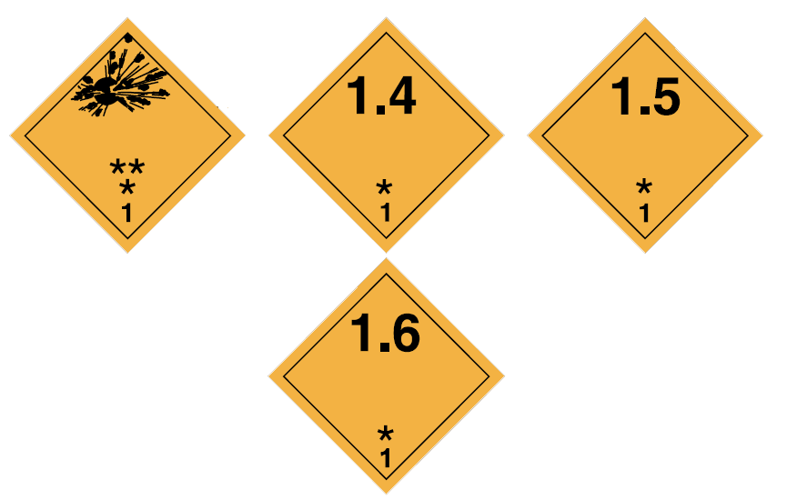
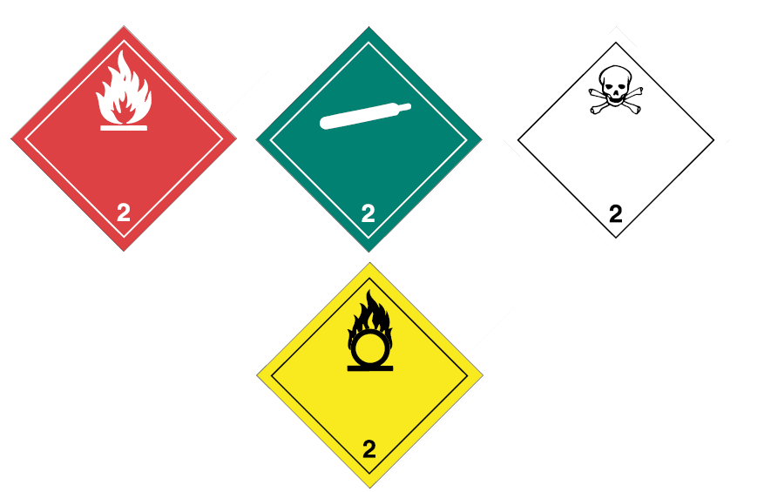
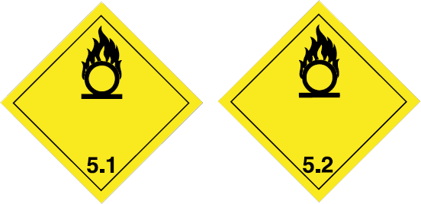
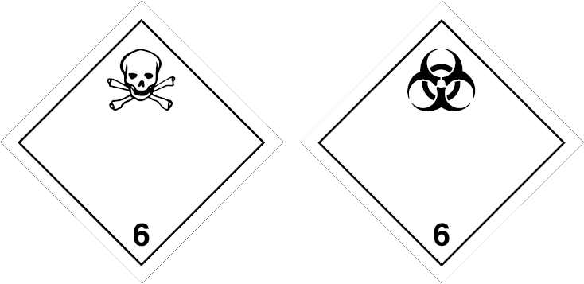
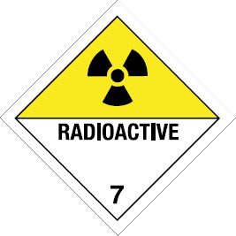
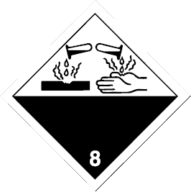
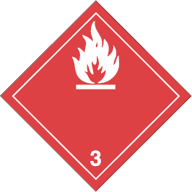
SAFETY MARKS & UN NUMBER
Safety Marks: Placards are diamond shaped rigid panels made of weatherproof material and use symbols, classes, color, and a UN (United Nations) number to give basic information about the dangerous goods being carried. This is the most common safety mark visible on railcars as they contain large quantities of product.
Identification Number (UN Number): Four-digit code with a ‘UN’ (United Nations) prefix used to identify hazmat/dangerous goods. May appear as shown in the center of the placard or on a separate orange label beside the placard.
1267

Slide 9
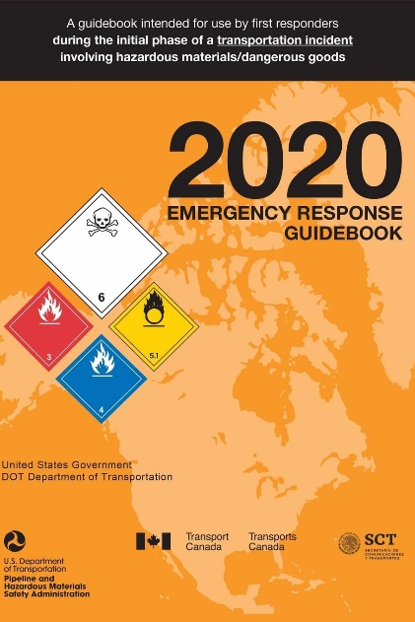
EMERGENCY RESPONSE GUIDEBOOK (ERG)
Intended for use by first responders during the initial phase of a transportation incident involving hazmat/dangerous goods.
US phmsa.dot.gov/training/hazmat/erg/emergency-response-guidebook-erg
CA tc.canada.ca/en/dangerous-goods/canutec/2020-emergency-response-guidebook#_Training_resources

Slide 11
FOR RESPONDERS FIRST ON THE SCENE
Upon arriving at a rail accident, an emergency responder should attempt to locate the train crew and get the train consist, which is a document that describes the make-up of the train.
If the crew and/or the train consist is not available, the emergency responder can use AskRail to query the Equipment ID for a specific railcar to find out its contents.
The app serves emergency responders who arrive first to the scene of a rail emergency and need critical information about the contents of a railcar.
Recommended for temporary use for safety isolation, evacuation, and/or assessment from a distance while securing the proper shipping paper.
RESPONDERS SHOULD SECURE THE TRAIN CONSIST OR WAYBILL BEFORE OFFENSIVELY APPROACHING THE RAILCAR.
ONLY INDUSTRY-QUALIFIED HAZMAT EMERGENCY RESPONDERS SHOULD
USE ASKRAIL.

Slide 12
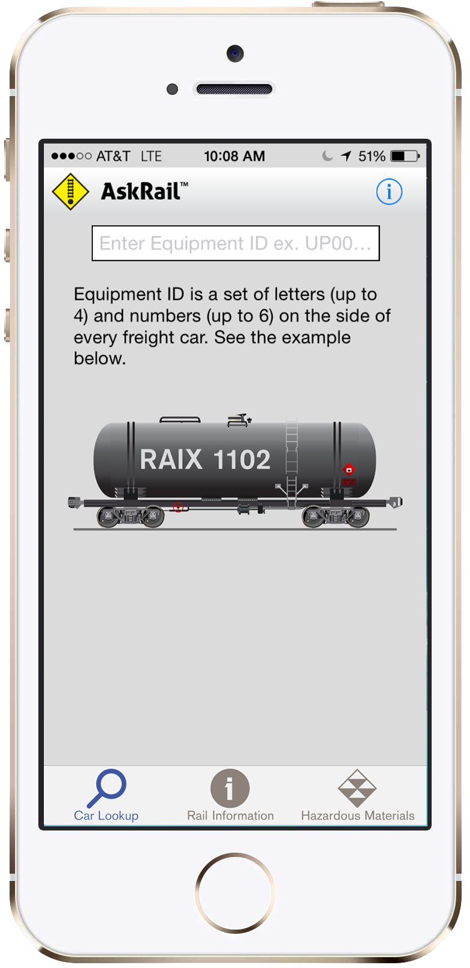
HOW IT WORKS
Enter rail car initials and numbers in the Car Query field.
Use RAIX1102 as pictured as a test car.
To check the contents of a container, enter the Container Number in the search field (do not enter the conveying railcar Equipment ID). The letters in a Container Number always end in “U” or “Z”.
AskRail has two security levels: Single Car Lookup and Train Consist Lookup

Slide 13
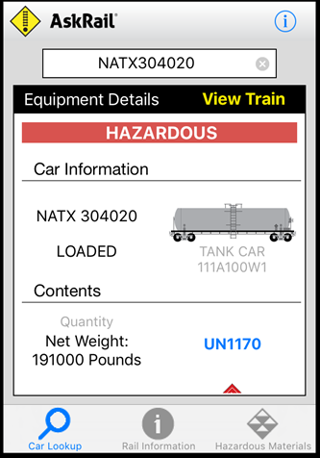
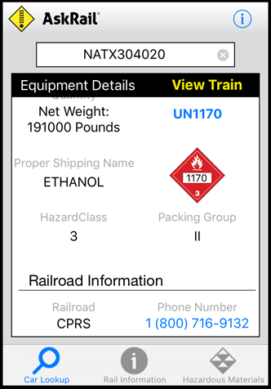
QUERY RESULTS (SINGLE CAR)
The query returns the following:
Loaded or empty status
Red Banner: Car is hazardous
Green Banner: Car is non-hazardous
United Nations/North America (UN/NA) ID for any located hazardous materials
Proper shipping name (PSN) for the railcar’s contents
Hazard class for the railcar's contents
Railroad name
Railroad’s emergency contact information

Slide 14
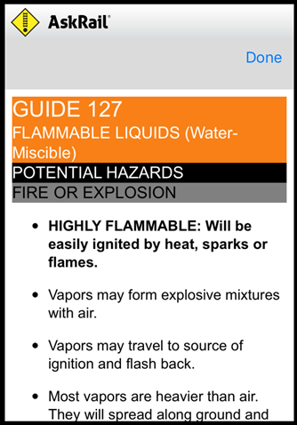
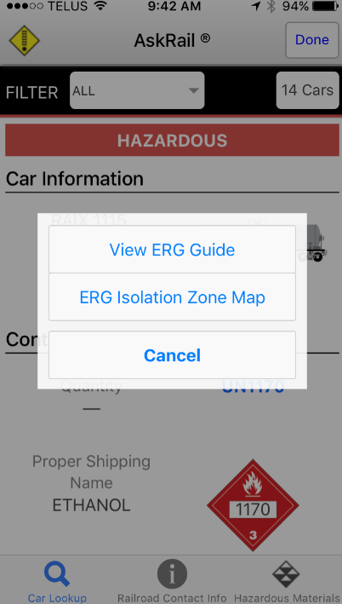
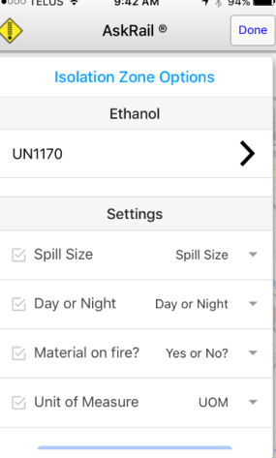
QUERY RESULTS (SINGLE CAR)
When you click the UN # or the Placard on the device, the Emergency Response Guide (ERG) appears for that UN Number. You can also choose the Isolation Zone, which will appear if listed in the ERG.

Slide 15
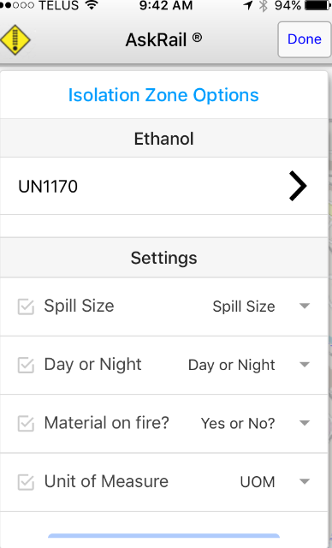
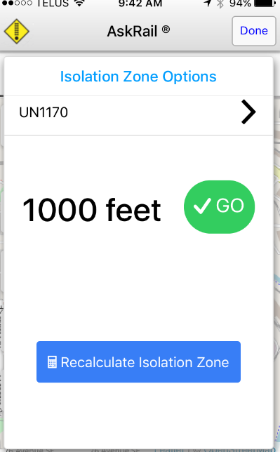
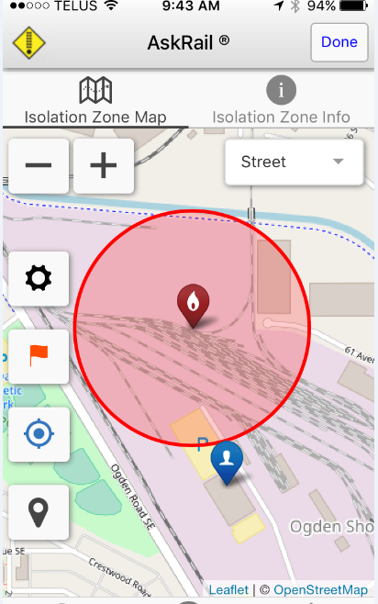
ISOLATION ZONE
1. Choose each setting.
2. Isolation in ft. is given.
3. Map is displayed.

Slide 16
CLASS I EMERGENCY NUMBERS
To call the emergency number, tap the number on the mobile app or dial if on desktop.

Slide 17
CLASS I EMERGENCY NUMBERS
BNSF Railway | 1-800-832-5452
Canadian National | 1-800-465-9239
Canadian Pacific | 1-800-716-9132
CSX Transportation | 1-800-232-0144
Kansas City Southern | 1-800-892-6295
Norfolk Southern | 1-800-453-2530
Union Pacific | 1-888-877-7267

Slide 18
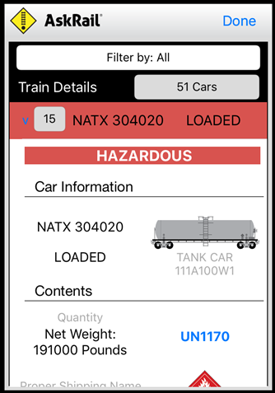
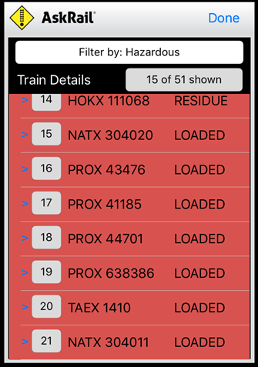
VIEW TRAIN QUERY
The Train Details screen displays the contents of the railcar associated with the entered equipment ID and allows you to scroll through a list showing the equipment IDs of each railcar in the consist. The Train Details screen also shows whether the railcar is loaded, empty, or contains residue. You can filter by All Cars, Hazardous Cars or Non-Hazardous Cars only.
If the Equipment ID is red, the railcar contains hazmat or hazardous residue.
Consist Lookup is generally restricted to Department Chiefs, Directors, Chief Officers, Company Officers, and designees of the Chief such as firefighters in charge of a hazmat team (exceptions may apply due to regional differences).
If you have permissions for the consist lookup functionality, a blue View Train link appears when you look up railcar contents. It may take 15 seconds or more for the View Train link to appear.
Important: The sequencing of the cars in the application may not match the sequencing of the cars on the paper consist, which is the compliance document and takes precedence in any discrepancy.

Slide 20
HOW TO INSTALL
Download from either Google Play, Apple app Store or the Windows app store.
Complete the registration process in the app on your device.
You will receive an email notification once your registration has been approved.
Once you have been approved to use the app, the app will become fully functional and ready for use.

Slide 21
QUESTIONS?
BNSF Railway | HazmatCommunityTraining@BNSF.com
Canadian National | askrail@cn.ca
Canadian Pacific | HMReports@cpr.ca
CSX Transportation | HazMatAdmin@csx.com
Kansas City Southern | AskRail@kcsouthrn.com
Norfolk Southern | HMAskRail@nscorp.com
Union Pacific | hmm@up.com

