Slide 2
1.375” TC128 Grade B Testing
SSAB Americas Steel Presentation
Miles Haberkorn – Applications Engineer
May 19, 2021

Slide 3
Background
During the AAR Steels Task Force meeting on August 25, 2020, the group discussed extending TC128 Grade B’s maximum thickness up to 1.25”
During the AAR Steels Task Force meeting on October 6, 2020, the group requested data to support a proposal to the AAR Tank Car Committee for increasing TC128 Grade B’s maximum thickness
During the AAR Steels Task Force meeting on November 10, 2020, the group discussed changing this request from 1.25” to 1.375”, which was ultimately accepted
To help facilitate this thickness increase, SSAB volunteered to roll a trial plate of 1.375” TC128 Grade B for a full evaluation
In addition, SSAB will perform the same evaluation on a 0.889” TC128 Grade B plate for comparison
The testing regime will include plate macroetches, longitudinal/transverse tensile tests, through-thickness tension tests, notched bar tensile tests, and longitudinal/transverse full CVN transition curves at quarter and mid-thickness locations
To represent steel toughness after tank car welding processes, simulated post-weld heat treatments of 1125°F for 83 minutes were conducted on plate sections from which the CVN specimens were machined

Slide 4
Chemistry Data
Heat | C | Mn | P | S | Si | Al | N | Cu | Ni | Cr | Mo | Sn | V | Nb | Ti
E0I271 | 0.21 | 1.37 | 0.008 | 0.001 | 0.32 | 0.030 | 0.007 | 0.22 | 0.11 | 0.16 | 0.04 | 0.008 | 0.04 | 0.00 | 0.002
TC128-B Min |  | 1.00 |  |  | 0.15 | 0.015
TC128-B Max | 0.24 | 1.65 | 0.025 | 0.009 | 0.50 | 0.060 | 0.010 | 0.35 | 0.40 | 0.30 | 0.12 | 0.020 | 0.08 | 0.02 | 0.02
Heat | B | CEV (IIW) | Cu+Ni+Cr+Mo | Nb+V+Ti | Ti/N Ratio
E0I271 | 0.0003 | 0.51 | 0.53 | 0.05 | 0.3
TC128-B Min
TC128-B Max | 0.0005 | 0.53 | 0.65 | 0.11 | 4.0
Italicized limits are per ASTM A20
Chemical composition the heat meets the TC128 Grade B requirements

Slide 5
1.375” Plate Macroetch

Slide 6
1.375” Plate Mechanical Testing Summary
Location | Direction | Test | 2% Yield Strength (ksi) | 5% Yield Strength (ksi) | Tensile Strength (ksi) | 2” Elongation (%) | Reduction of Area (%)
Quarter-t | Transverse | 1 | 60.8 | 60.2 | 90.8 | 32.9 | 60.0
Quarter-t | Transverse | 2 | 59.1 | 59.4 | 90.2 | 30.9 | 60.3
Mid-t | Transverse | 1 | 58.7 | 59.4 | 92.0 | 24.0 | 50.4
Mid-t | Transverse | 2 | 59.6 | 60.2 | 91.9 | 28.3 | 48.9
Quarter-t | Longitudinal | 1 | 61.8 | 61.6 | 90.3 | 31.8 | 60.0
Quarter-t | Longitudinal | 2 | 61.4 | 61.3 | 90.4 | 35.6 | 61.1
Mid-t | Longitudinal | 1 | 60.7 | 61.1 | 92.1 | 29.6 | 50.8
Mid-t | Longitudinal | 2 | 59.8 | 60.1 | 91.8 | 30.0 | 50.3
TC128-B | Transverse |  | ≥50 |  | 81 – 101 | ≥22
0.505” round tensile tests were performed in the as-normalized condition
All locations and all directions pass the minimum requirements for TC128 Grade B

Slide 7
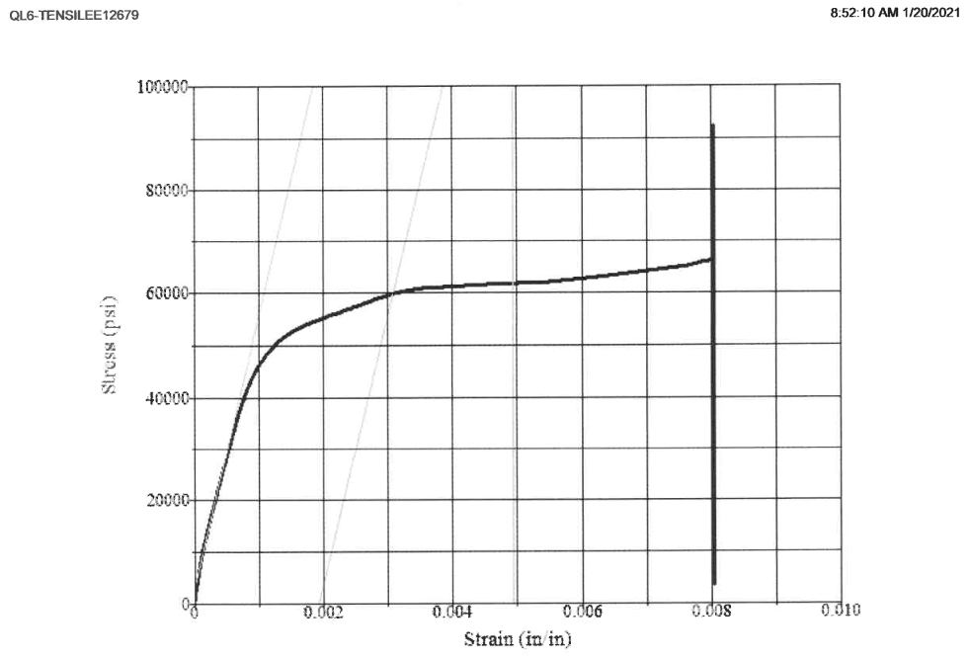
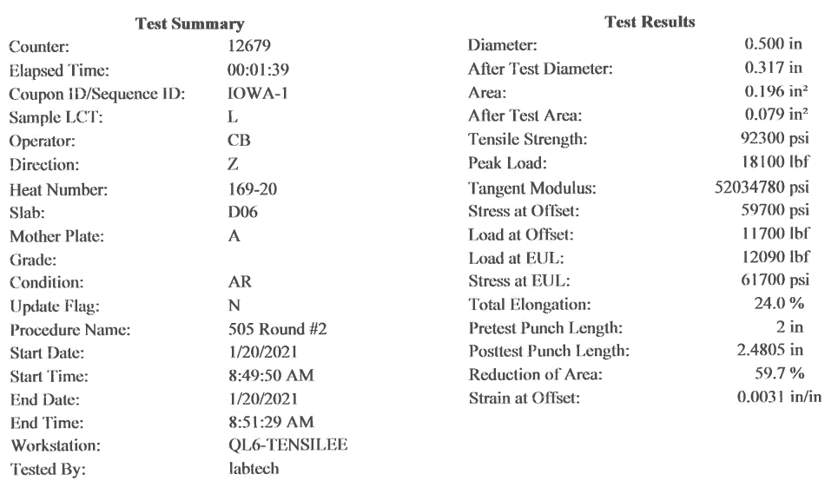
1.375” Plate Z-Testing Summary
The Reduction of Area (RoA) for the first specimen was 59.7%
The second specimen broke outside the weld therefore the results are invalid
Although AAR TC128 Grade B material does not typically require Z-tests, these RoA values significantly exceed ASTM A770 requirements of 20%

Slide 8
1.375” Plate SPWHT Charpy Impact Testing Summary
Location | Direction | Size (mm) | Temp (°F) | Abs. Energy 1 / 2 / 3 (ft-lbs) | Avg. Energy (ft-lbs)
Quarter-t | Longitudinal | 7.5 | 64.4 | 141 / 168 / 157 | 155
Mid-t | Longitudinal | 7.5 | 64.4 | 119 / 97 / 99 | 105
Quarter-t | Transverse | 7.5 | 64.4 | 156 / 133 / 145 | 145
Mid-t | Transverse | 7.5 | 64.4 | 121 / 121 / 117 | 120
Quarter-t | Longitudinal | 7.5 | 32 | 137 / 173 / 140 | 150
Mid-t | Longitudinal | 7.5 | 32 | 89 / 95 / 77 | 87
Quarter-t | Transverse | 7.5 | 32 | 115 / 121 / 115 | 117
Mid-t | Transverse | 7.5 | 32 | 87 / 87 / 91 | 88
Quarter-t | Longitudinal | 7.5 | -4 | 107 / 120 / 95 | 107
Mid-t | Longitudinal | 7.5 | -4 | 72 / 53 / 51 | 59
Quarter-t | Transverse | 7.5 | -4 | 97 / 80 / 105 | 94
Mid-t | Transverse | 7.5 | -4 | 32 / 72 / 96 | 67
Quarter-t | Longitudinal | 7.5 | -30 | 84 / 97 / 75 | 85
Mid-t | Longitudinal | 7.5 | -30 | 49 / 31 / 23 | 34
Quarter-t | Transverse | 7.5 | -30 | 63 / 101 / 84 | 83
Mid-t | Transverse | 7.5 | -30 | 80 / 68 / 56 | 68
Quarter-t | Longitudinal | 7.5 | -50 | 51 / 28 / 67 | 49
Mid-t | Longitudinal | 7.5 | -50 | 51 / 9 / 13 | 24
Quarter-t | Transverse | 7.5 | -50 | 41 / 79 / 59 | 60
Mid-t | Transverse | 7.5 | -50 | 52 / 28 / 25 | 35
Quarter-t | Longitudinal | 7.5 | -76 | 48 / 41 / 33 | 41
Mid-t | Longitudinal | 7.5 | -76 | 29 / 37 / 7 | 24
Quarter-t | Transverse | 7.5 | -76 | 39 / 45 / 31 | 38
Mid-t | Transverse | 7.5 | -76 | 16 / 24 / 32 | 24
Quarter-t | Longitudinal | 7.5 | -112 | 21 / 11 / 20 | 17
Mid-t | Longitudinal | 7.5 | -112 | 13 / 12 / 3 | 9
Quarter-t | Transverse | 7.5 | -112 | 15 / 16 / 13 | 15
Mid-t | Transverse | 7.5 | -112 | 9 / 11 / 12 | 11
TC128-B Requirements |  |  | -50 | ≥10 | ≥15
Energy absorbed values are calculated full-size equivalents since sub-sized specimens were tested (7.5 mm)
All locations and all directions pass the minimum requirements for TC128-B down to -30°F (-34.4°C)
Aside from longitudinal mid-t CVNs, all locations and all directions pass the minimum requirements for TC128 Grade B down to -76°F (-60°C)
Quarter-t longitudinal and transverse CVNs pass down to -112°F (-80°C)
Metallography and fractography were performed on the longitudinal mid-t CVN specimen with values of 51/9/13; however, these did not provide any explanation for the differences in energy

Slide 9
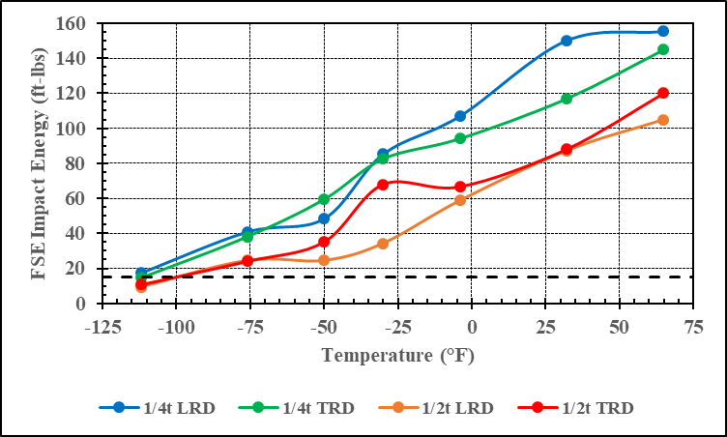
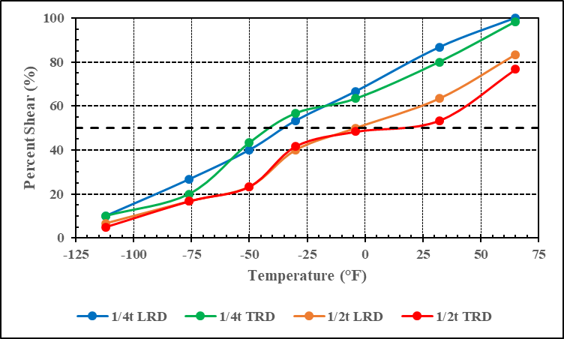
1.375” Plate SPWHT Charpy Impact Curves
Ductility Transition Temperature, DTT (15 ft-lb threshold)
Fracture-Appearance Transition Temperature, FATT (50% shear threshold)
Quarter-t 15 ft-lb ductility transition temperature is around -112°F (-80°C) and the fracture-appearance transition temperature is around -35°F (-37°C)
Mid-t 15 ft-lb ductility transition temperature is around -99°F (-73°C) and the fracture-appearance transition temperature is around 14°F (-10°C)

Slide 10
1.375” Plate Notched Bar Tensile Testing Summary
Notch | Direction | Test | 2% Yield Strength (ksi) | 5% Yield Strength (ksi) | Tensile Strength (ksi) | 2” Elongation (%) | Reduction of Area (%)
0.25” | Longitudinal | 1 | 91.3 | 97.6 | 111.6 | 6.9 | 56.1
0.25” | Longitudinal | 2 | 88.9 | 100.6 | 113.2 | 6.3 | 52.2
0.10” | Longitudinal | 1 | 98.8 | 108.2 | 116.5 | 5.0 | 46.4
0.10” | Longitudinal | 2 | 100.5 | 109.5 | 117.2 | 5.4 | 51.2
0.05” | Longitudinal | 1 | 116.5 | 125.7 | 131.6 | 3.8 | 42.5
0.05” | Longitudinal | 2 | 119.0 | 126.4 | 133.1 | 4.3 | 42.0
Notched tensile tests were performed in the as-normalized condition
As stress triaxiality increases (notch becomes more severe), the yield and tensile strength increase while the ductility decreases

Slide 11
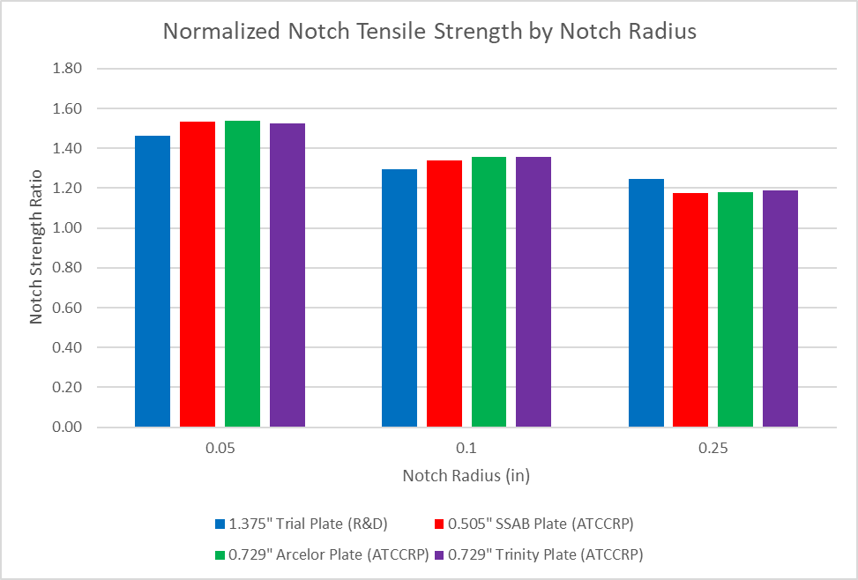
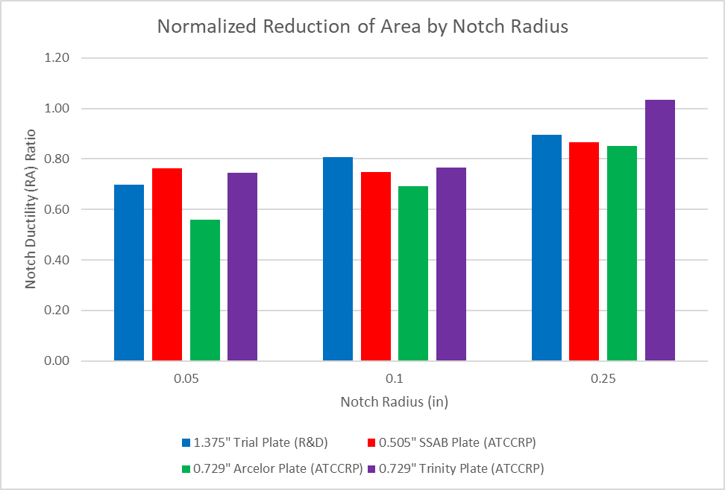
Notched Bar Tensile Testing Comparison
To help evaluate the notched bar tensile test results, the Notch Strength Ratio and Notch Ductility Ratio are calculated and compared to results from ATCCRP Report for Project TWP-10
These values normalize the notch UTS and RoA values with the standard tensile specimen
The 1.375” material has slightly lower Notch Strength Ratios on severe notches, but similar or better Notch Ductility Ratios on all notches

Slide 12
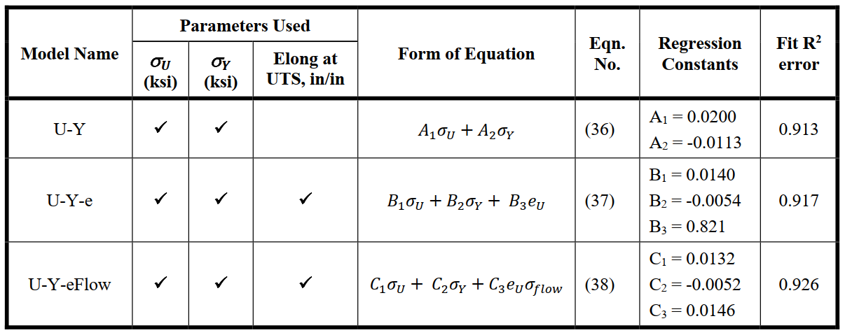
Predicted Normalized Puncture Energy
To evaluate the puncture resistance of the thicker TC128 Grade B material, the Predicted Normalized Puncture Energy (E_{fit}) was calculated using 3 models from the ATCCRP Report for Project TWP-10
Below are the formulas for each model, which use a combination of yield strength, tensile strength, elongation at UTS, and flow stress to determine the puncture energy
The ATCCRP Report recommends use of all 3 models in conjunction as candidate tank car materials are likely to perturb the input variables beyond the calibration range; however, this does give us a rough idea of how the thicker TC128 Grade B material will perform

Slide 13
1.375” Plate Predicted Normalized Puncture Energy
Location | Direction | Test | 2% Yield Strength (ksi) | Tensile Strength (ksi) | Elongation_{UTS} (%) | E_{fit} (U-Y Model) | E_{fit} (U-Y-e Model) | E_{fit} (U-Y-eFlow Model)
Quarter-t | Transverse | 1 | 60.8 | 90.8 | 16.6 | 1.13 | 1.08 | 1.07
Quarter-t | Transverse | 2 | 59.1 | 90.2 | 16.8 | 1.14 | 1.08 | 1.07
Mid-t | Transverse | 1 | 58.7 | 92.0 | 14.6 | 1.18 | 1.09 | 1.07
Mid-t | Transverse | 2 | 59.6 | 91.9 | 16.8 | 1.16 | 1.10 | 1.09
Quarter-t | Longitudinal | 1 | 61.8 | 90.3 | 16.4 | 1.11 | 1.07 | 1.05
Quarter-t | Longitudinal | 2 | 61.4 | 90.4 | 16.6 | 1.11 | 1.07 | 1.06
Mid-t | Longitudinal | 1 | 60.7 | 92.1 | 16.6 | 1.16 | 1.10 | 1.09
Mid-t | Longitudinal | 2 | 59.8 | 91.8 | 16.6 | 1.16 | 1.10 | 1.08
All locations and all directions display E_{fit} values greater than 1, which means that all of these tests have a higher predicted puncture energy than TC128 Grade B material from the Next Generation Railroad Tank Car Project
Mid-thickness tests exhibited better puncture resistance due to the increase in ultimate tensile strength, decrease in yield strength, and little difference in elongation at UTS

Slide 14
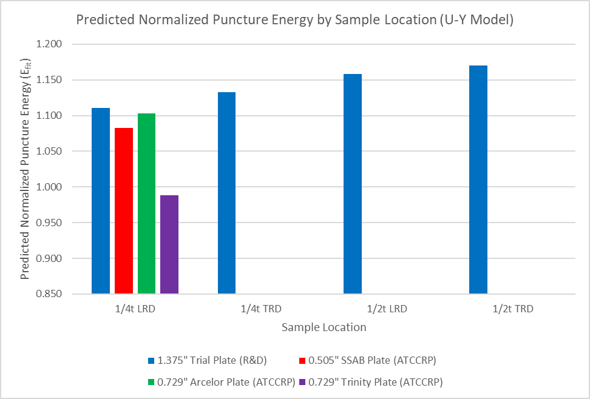
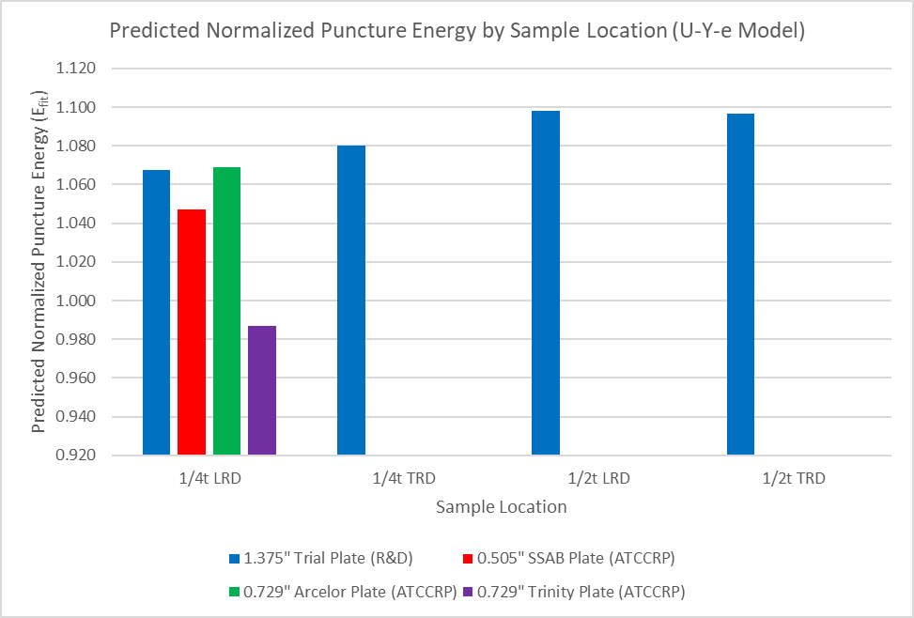
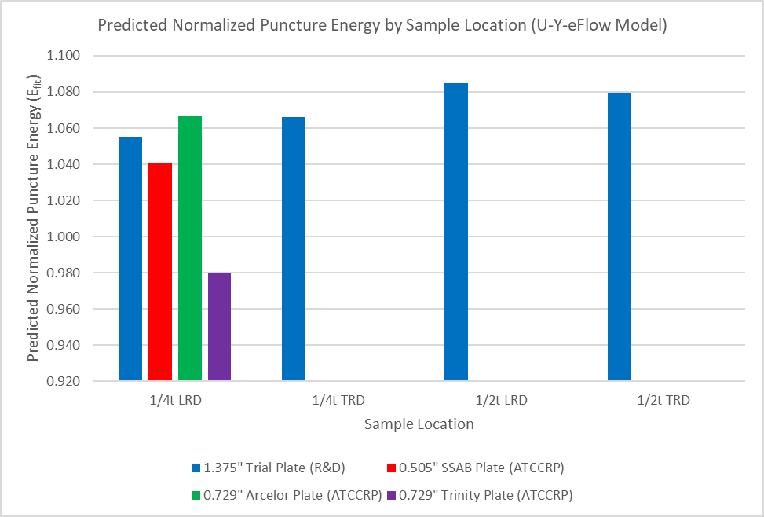
Puncture Energy Comparison
In general, trial material displays better predicted normalized puncture energy than material from the ATCCRP Report for Project TWP-10
For all sample locations, the quarter-thickness longitudinal samples displayed the lowest predicted normalized puncture energy due to having the highest yield strength and lowest ultimate tensile strength
ATCCRP report states that the average normalized puncture resistance for various materials tested was 1.08±0.1 (±2 std devs); therefore, these results are statistically not different than TC128 Grade B material from the report

